Slide 1
NASDAQ-100
STOCK PREDICTOR
LAYLAA
ASHLEY
VAMSI
MELIHA

Slide 2
Contents
Project Goal & Plan
Data Sources
Tools Used
Design & Design Considerations
Python Calls
Beautifulsoup for News Hyperlinks
Auto ARIMA Model
How it works
Project Demo
Final phase actions

Slide 3
Project Goal & Plan
To try different Machine Learning models on Nasdaq-100 index and predict the value of the stock for next day based on current day’s closing.
28 March 2020
4 April 2020
8 April 2020
15 April 2020
Finalize Roadmap
Prediction Builder
Develop Front End - Submit Project
Deploy in Cloud
Data Source
Roles & Deliverables
Tools to be used
Try different ML models
Find the better fit
Integrate the prediction data to front end on a local machine
Demo to class
Integrate Web Searches
Deploy to cloud
Demo to industry

Slide 4
Data Sources
Finnhub.io
Stock Data - Candlestick, ticker
(https://finnhub.io/docs/api)
Nasdaq
For getting Nasdaq 100 index stocks (https://www.nasdaq.com/market-activity/quotes/nasdaq-ndx-index)

Slide 5



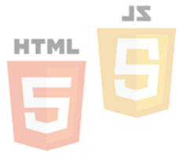






Tools Used
In Current Phase
Scikit-Learn
Python Pandas
Python Matplotlib
HTML/CSS
JS Plotly
D3.js
Beautiful Soup
In Next Phase
AWS

Slide 6
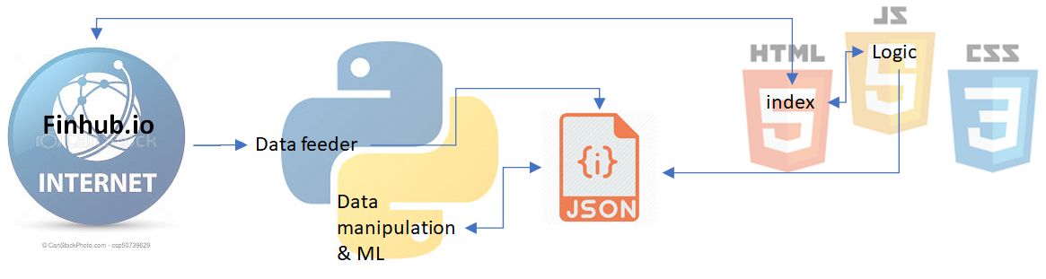
Design & Design Considerations

Slide 7
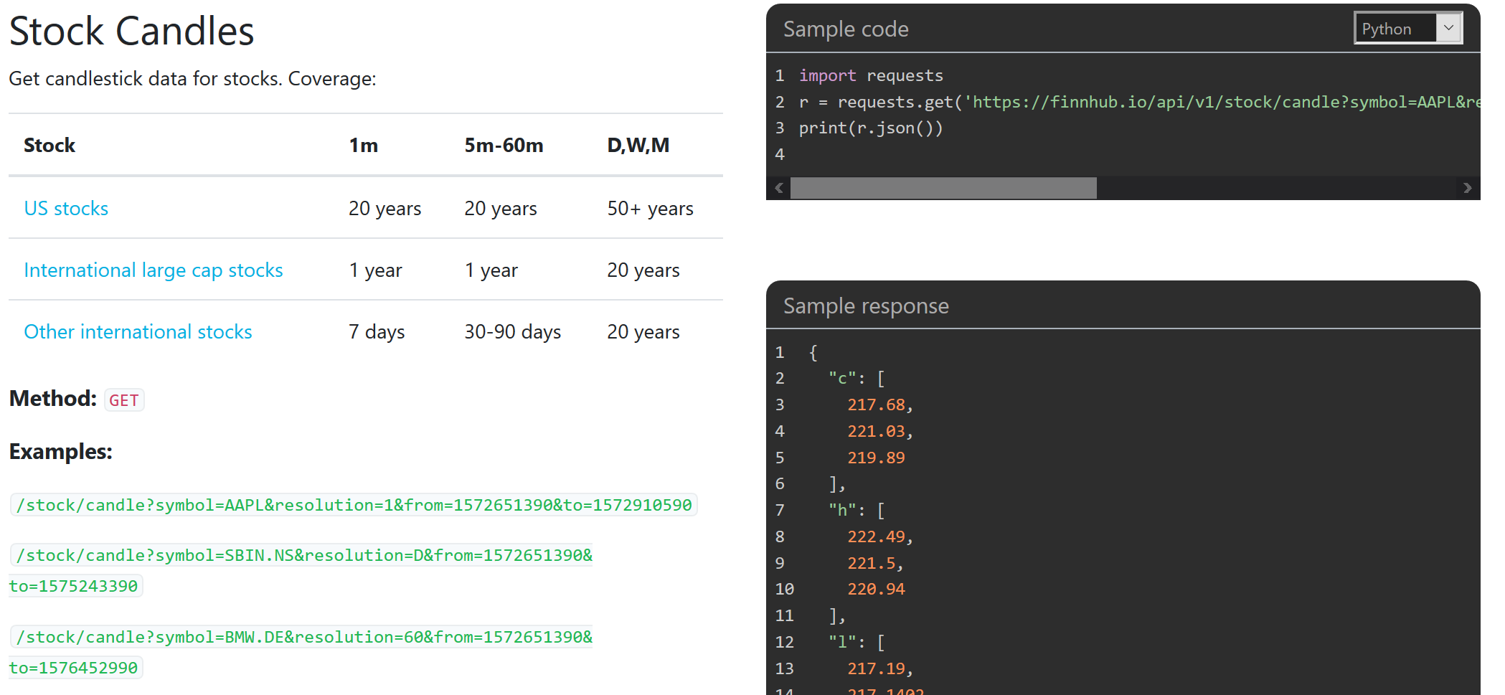
Python Calls
API calls to Finnhub.io for fetching candlestick data for stocks.
Generating predicted values and saving them as JSON for use in JS.

Slide 8
Beautifulsoup for News links
Nasdaq website stock headlines
beautifulsoup object was created and used for all links
extract links from website into array
called in function to extract
Create for loop to print the data
Create dataframe to save as CSV and concat CSVs to one master CSV
then to be deployed on AWS

Slide 9
Auto ARIMA Model
Stock prediction, researched online for 1 day stock prediction, this model was the best
What is Auto Arima?
High performance time series model
Autoregressive Integrated Moving Average
Describes correlation between data points
Works with differences of the value

Slide 10
How it works? (Contd.)
Consists of 3 Components:
AR (auroregressive term)
I (differencing term)
MA (moving Average term)
Works on 2 assumptions

Slide 11

Project Demo
abrakadabra!!!

Slide 12
Final Phase Actions
Integrate News hyperlinks to frontend
Deploy the project on AWS
Fine tune the frontend to make it more professional

Slide 13
Thank You
Show me the money :P

